Slide 1
Social Interaction Detection
Hsiao-Yuan Chen, Grace Lee
Notes:
Hello everyone. I am __, and this is my teammate __. For the final project we built a system that detects various forms of social interaction from audio data.

Slide 2
Goals
Detect various forms of social interactions from audio data
E.g. given an audio recording, the system will classify if it’s a person talking alone, giving a lecture, two people chatting, arguing… (the list goes on)
Notes:
The goals we had in mind when we designed and built this system is, when we are given audio data, we want to know what kind of social interaction is present in the audio data. Specifically, we have a set of possible categories, which we will cover in the next slide.

Slide 3
Some questions
Can our system successfully classify each audio clip to each category?
Previous research has shown that when a person speaks in a different language, their voice changes. How will our system behave?
Are some languages more likely to be misclassified?
Notes:
Ok, so let’s look at a few questions before we dive deeper.
First of all, we want to know the accuracy, precision, and recall of our system.
Secondly, my teammate and I are both trilingual or bilingual. I’m sure many of you can speak more than one language as well. Have you noticed that you have a different voice when you speak a different language? What happens if you switch between languages in one conversation? We wanted to see that when we train with audios where the speaker speaks the same language from beginning to end, and then we test with audios where the speaker switches languages, if our system would classify that as one person speaking or two people.
Finally, this is our third question.

Slide 4
Motivation
Social interaction plays an important role in our lives
Assist visually impaired people
Assist hearing impaired people
Mitigate cultural barriers
Notes:
Even in these Covid times, social interaction is still very important in our lives. And now when everyone is wearing a mask, it’s somewhat harder to detect emotions from facial expressions.
Next, we think this system can help visually impaired people. In some of the clips we found, it was hard for us to distinguish whether the two people are chatting or arguing just from the audio alone. We, as human beings, had to watch the videos as well to make sure.
For some other clips, on the other hand, were of people arguing while standing calmly. From the videos alone, our eyes cannot distinguish whether they were having a nice chat or arguing. We had to listen to them.
Another reason we decided on this topic is that due to Covid, my teammate and I are 14 time zones away. We are in two different places where the culture is different and the languages used are different. We were curious to see if people in different cultures express the same social interaction differently.
下面不要念=================================
Q: Why did you use audio data? Wouldn’t it make more sense to use video?
A: First of all, audio data is easier to collect than video. For example, you can record even if you put your phone in your pocket or bag. With a camera, you have to make sure where the camera is aimed at.
Q: why didn't we use speech to text detection? That's readily available. But this would limit us to the major languages in the world.
One reason we took the effort to include many languages is because the two of us are bilingual or trilingual. I’m sure many of you can speak more than one language as well. Have you noticed that you have a different voice when you speak a different language? What happens if you switch between languages in one conversation? We wanted to see that when we train with audios where the speaker speaks the same language from beginning to end, and then we test with audios where the speaker switches languages, if our system would classify that as one person speaking or two people.

Slide 5
Category | Description
Alone | A person talking alone, e.g. reading a passage
Chatting | 2 people having a conversation
Phone | One-sided phone conversation (i.e. there could be large gaps of silence)
Lecture | A person giving a lecture
Eating | One or more people talking while eating
Arguing | Arguments between 2 or more people
Notes:
These are our categories. We take an audio recording as input and try to classify which of these categories it belongs to.
The categories Alone, Phone, and Lecture only have one person in them. What’s the difference between these three? Well, audio recordings in the Alone category has a person reading a passage or delivering a monologue. Next, imagine eavesdropping(e-vas-dropping) on your friend talking on the phone. You will only hear one side of the conversation, right? That’s what our Phone category sounds like.
For lecture, we found videos where the lecturer interacts with students, or where we can hear the lecturer writing on the blackboard.
The categories with more than one person are Chatting and Arguing.
To make this project more interesting and more difficult, the chatting category, we specifically chose clips where one speaker is almost silent.
For eating, we found and recorded videos and audio clips where we can hear chewing or the clanging of utensils.
Next, my partner Grace will talk more about the data set.
下一頁換Grace

Slide 6
Data Set
We recorded some of the audio clips, and downloaded the rest from youtube
10 or more audio clips in each category
45 to 60 seconds in each
Languages: Amis, Atayal, Bunun, Cantonese, Dutch, English, Japanese, Korean, Mandarin, Russian, Taiwanese, and one unidentifiable (from the Middle East or South Asia)
Notes:
We collected this data set ourselves. We didn’t use any readily available database.
Some of the audio clips we recorded ourselves, or asked our friends to record for us. However, we wanted to obtain a richer dataset, for example, we don’t want only 3 languages in our data. And we don’t want one gender to dominate our recordings. Also, for some of our categories, such as arguing or giving a lecture, it’s impossible to record all of them by ourselves. Furthermore, we want at least 10 recordings in each category. Therefore, we searched for suitable videos on youtube.
At first we trained with recordings of length 3 to 5 minutes. Unfortunately, that took too long to run, so we trimmed all of our recordings down to 45 to 60 seconds.
We made sure to have about half male and half female in each category so that we don’t have gender bias. For example, if you search for “arguing” on youtube, the majority is of crazy women yelling and screaming. On the other hand, if you search for “OCW” or “lecture” on youtube, then the majority is men. If we just randomly download stuff from youtube, it might make our system a bit biased. This is why we spent a lot of time and effort making sure that our data is more balanced.
Another interesting part of our data set is that we included several language families. Amis, Atayal, and Bunun are endangered languages from the Austronesian language family (滑鼠在前三個語言繞圈圈). Dutch, English, and Russian are European. The rest are from Asia.

Slide 7
Contribution
Utilize audio (and audio only) to classify social interaction
Demonstrate the difference between a training set with 1 language, and a richer training set with multiple languages

Slide 8
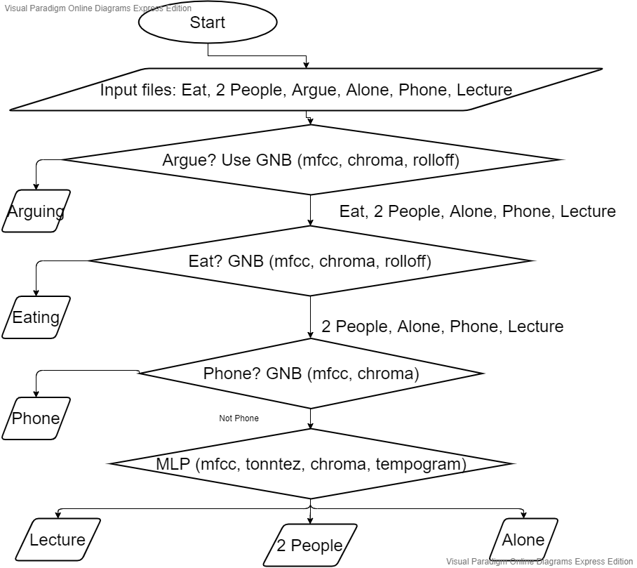
Methods
Separate “Argue” from the other 5
Separate “Eat” from the other 4
Separate “Phone” from the other 4
Separate “Lecture”, “2 People”, and “Alone” from each other
Notes:
We classified our input files layer by layer. First, we separate “argue” from the other 5 categories. The features we used were mel frequency cepstral coefficients, chroma, and rolloff.

Slide 9
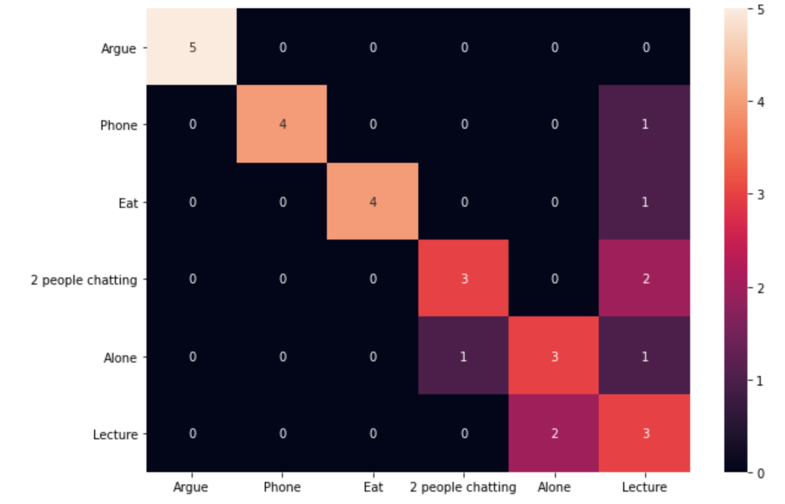
Results
Notes:
This is the confusion matrix from our test data. We have 5 recording in each test category.
Our system was able to distinguish “Argue” from all the other categories.
At the bottom right, you can see that 2 people chatting, alone, and lecture are less distinguishable. First of all, the Alone that was classified as 2 people chatting was a person acting as two people.
When we trained with a single language only, and tested with the same language, the accuracy was 100%.

Slide 10
Future Work
More categories/emotions/interactions
Less generalized models
Notes:
Create a more specific model for different languages or cultures.

